Slide 1



Productive Writing Skills & Test
A Short but Intensive Program
Gumi, Summer 2024
by Seanan

Slide 2



Introduction
Welcome!
Program Overview
Practical Strategies
Welcome to our intensive 3-hour writing instruction workshop for high school teachers.
We'll cover a brief overview of the program, including discussion and practical strategies for teaching writing.
The main focus will be on sharing practical, effective strategies for teaching writing in the high school classroom.
This PPT and all supporting Materials can be found online at: www.teflsites.com

Slide 3




Part 1: Discussing Writing in High School
Ask/Answer Questions
Engage in a group discussion, asking and answering questions about teaching writing in the high school classroom.
Write Feedback on a Poster
Work together to create a poster summarizing key insights and strategies from the discussion.
Present Your Poster
Share your poster with the class, highlighting the most important points about high school writing instruction.

Slide 4
Introductions
Introduce Yourself
1
2
What Grades/Subjects do you teach?
How Long Have You Been Teaching?
3
Take a moment to briefly introduce yourself to the group. Share what grade(s) and subject(s) you teach, as well as how long you've been teaching.

Slide 5
Content and Methods
1
Writing in the Classroom
2
Writing Skills Focused On
3
Writing Formats and Genres
Do you cover writing in your high school classes? How do you structure your writing lessons?
What specific writing skills do you emphasize with your students (e.g., narratives, descriptive writing, essays)?
Are there any particular writing formats or genres that you focus on in your instruction?

Slide 6
Challenges and Effective Strategies
4
Challenges
5
Effective Strategies
What are some challenges you face when teaching English writing to high school students?
Can you share any strategies or techniques that have worked well in improving your students' writing skills?

Slide 7
Assessment and Feedback
6
Evaluate Criteria
7
Provide Feedback
What criteria do you use to evaluate writing proficiency?
How do you assess and provide feedback on students' writing assignments?

Slide 8
Student Engagement and Motivation
8
Engagement and Motivation
9
Specific Activities
How do you keep students engaged and motivated during writing lessons?
Are there any specific activities or projects that have sparked enthusiasm for writing among your students?

Slide 9

Technology in Writing Instruction
10
Digital Tools
Do you use any technology or digital tools to enhance English writing instruction?
11
Balancing Traditional and Technological
How do you balance traditional writing methods with technology-based approaches?

Slide 10
Part 2: Writing Formats and Tasks
Okay, let’s move on to some Writing Formats and Tasks that you could teach your students (if you have the time and energy in your curriculum) ☹
What do you know about these formats?
  Structural Writing
  Skills and Processes
  Definition, Process, Descriptive, Opinion, Summary, Narrative, Reflective Writing
Note: What criteria would you use to evaluate students who do each of these activities?
(I will offer some rubrics, but I’d like your ideas too! ☺

Slide 11



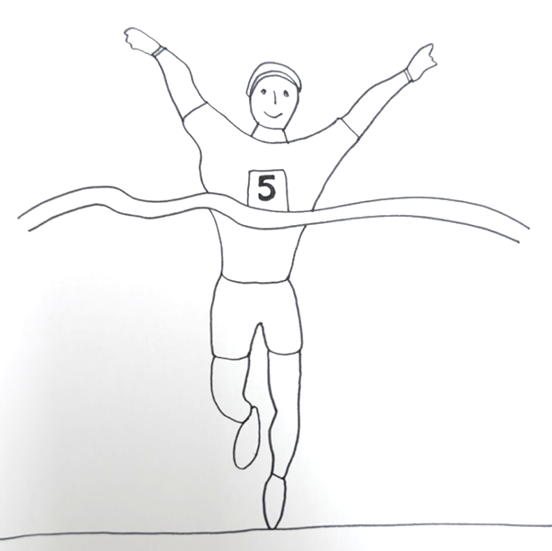
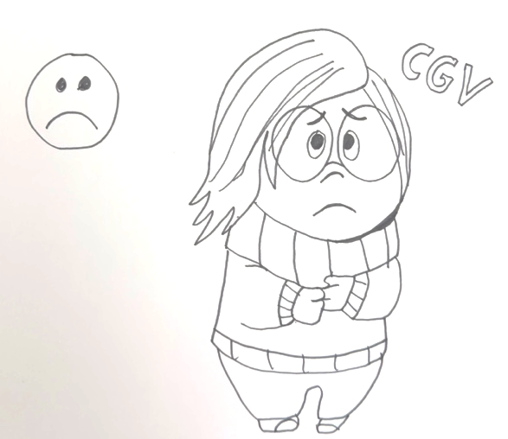

Structural Writing
Writing courses, particularly at beginning level can be organized around grammar and sentence patterns. For example, we could look at the Present Perfect Simple (not an easy one to start with).
Form / Use / Guided Practice / Writing Practice
Seanan has eaten a worm.
Seanan has lived in Korea for 8 years.
Seanan has cut his finger.
Seanan has won a marathon.
Seanan has not seen Inside Out 2 yet.
Can you/students draw your/their own pictures/make sentences, and then have your/their partner make a Present Perfect sentence?
Maybe you could turn this into a 5 truths and 1 lie game?

Slide 12

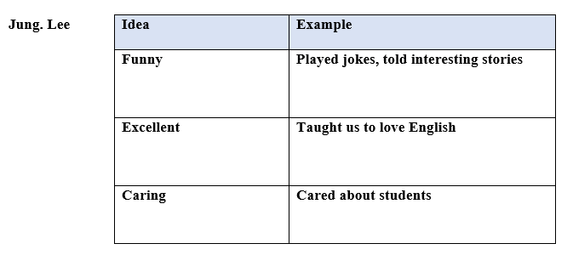
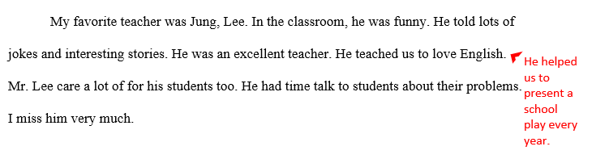
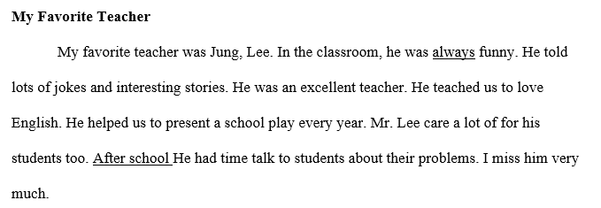
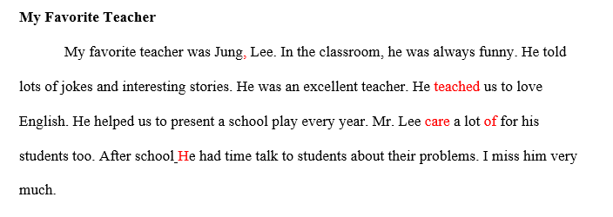
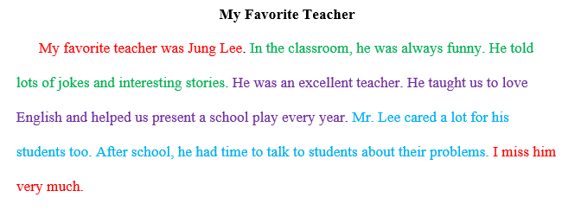
Skills and Processes
Coming up with Ideas (Pre-Writing)
Putting your Ideas into Order
The First Draft
Revising
Proofreading
The Final Draft
Extra: I know these are a little simple for high school, but you could use Plant / Hamburger Templates (see Online).

Slide 13

Definition Writing
In definition writing, the writer’s main purpose is to tell you what something is.
A definition writing
Explains what something is
Gives facts, details, and examples to make the definition clear to the reader
In the dictionary, the Sun is a huge ball of fire in space that gives us light and heat. It's very big and far away, but I can see it during the day. The Sun helps plants grow and gives us energy to play outside. Without the Sun, there would be no daytime or warmth on Earth!
Start with a dictionary definition,
then give your ideas

Slide 14

For a bit of fun, let’s make a Balloon Turtle Bracelet. 😊
Process Writing
In a process paragraph, you explain how to do something step by step. First, you list the steps in order, using words like "first," "next," and "finally" to show when each step happens. At the end, you have a specific result.
First, take a balloon and blow it up about halfway with the inflator tool and tie the end. Now, pinch the tied part with your fingers and push it in and up, twisting it to make a 'tulip twist'. Twist around the tied part to form the turtle’s head. Next, twist the balloon below the head to make a small body (about 3 fingers). Then, make four legs by twisting sections evenly (about 2 fingers each). Twist the legs together a few times. Now, carefully push the turtle body through the legs. Next, hold the tail part of the balloon, snip the end to let most (not all) of the air out, then tie a knot below the snip. To make the bracelet band, take the tail part and wrap it around the neck of the turtle a few times. Your cute turtle bracelet is ready to design and wear!
A process analysis paragraph
- Explains a sequence or process
- Presents facts and details in chronological order
- Uses time words or phrases
- Ends with a specified result

Slide 15

Descriptive Writing
A descriptive writing describes how something or someone looks or feels.
A descriptive writing
- Describes
- Gives impressions, not definitions
- “shows” the reader
- Creates a sensory* image in the reader’s mind
* related to the five senses: hearing, taste, touch, sight, smell
Sight:
Hershey's Kisses are small and shiny, wrapped in silver foil with a little paper tag.
Touch:
The foil crinkles when you touch it.
Sound:
When you unwrap it, you hear a soft crinkle as the foil opens up.
Smell:
They smell sweet and chocolatey.
Taste:
When you take a bite, they melt in your mouth with a delicious chocolate flavor.

Slide 16



Opinion Writing
Have you ever thought about getting a dog
as a pet? I think dogs make great pets
because they are loyal, playful and helpful.
An opinion writing expresses the writer’s opinion.
An opinion writing:
Introduction
- Gives the writers opinions about a topic
Hook
The first reason dogs make great pets is that they are loyal. Some dogs travel hundreds of miles to be with their humans! Another reason dogs make great pets is that they are playful. Dogs can run, camp, and hike with their owners. Finally, dogs make great pets because they can be helpful. They can guard, hunt, guide and protect.
- Interprets or explains facts
State your opinion
- Is often about a controversial issue
List 3 main reasons
- Makes the reader think
Body
- Considers both sides of the argument
Reasons 1/2/3
Support each reason with an example, fact or detail
Use transition words between reasons
Conclusion
Restate your opinion in different words
These are the reasons why I believe dogs make great pets. If you are considering getting a pet, choose a dog, you’ll be glad you did!
Snap
Extra: You could use the OREO Template. Also, it is useful to have students use Transitional Words and Phrases, and Expressions for Discussion and Debate; they really help (see Online).

Slide 17
Summary Writing
A summary tells the most important parts of a text in your own words.
1
Clear
2
Topic Sentence
3
Main Points
Understandable to those who haven't read the original.
Starts with the author/source and main idea.
Includes all main points in the same order, without minor details.
4
Brief
5
Original Words
6
Objective
About one-quarter the length of the original. Use Transitional Words and Phrases and Reporting Verbs (See Online).
Written in your own words, no copying or quotes (technical terms can remain). Use a Thesaurus.
Only the ideas from the original, no personal opinions or changes in meaning.
7
Conclusion
Ends with the author's conclusion

Slide 18
How I have my students write a Summary:
Read Carefully: Read the text several times to understand it fully. Take notes and look up unfamiliar words.
Identify Main Points: Find and list the most important points in the order they appear.
Write from Notes: Use your notes to write the summary, not the original text.
Check for Accuracy: Compare your summary with the original to ensure different wording and all main points are included.
Revise and Edit: Fix grammar, punctuation, clarity, capitalization, or spelling errors.
Summary Template
Original Story | Your Notes
Summary
Summary Example (see Online).

Slide 19
Narrative Writing
Narrative writing can be fun to write because you tell a story or relate an event. Narratives have a beginning, a middle, and an end. Any time you go to a movie or read a fiction book, you are looking at a narrative. Narrative writing often describes events from the writer’s life.
What can you do with these writing prompts?
https://bogglesworldesl.com/creativewriting.htm
A narrative paragraph
- Tells a story
What about this Writing Bubble?
https://teflsites.com/GUMI%20Bubble%20Diagram.pdf
- Gives background information in the opening sentence(s)
- Has a beginning, a middle, and an end
- Entertains and informs
Or this Writing Dice?
https://teflsites.com/GUMI%20The%20Dice%20Game.pdf
Example Narrative Writing
My Gumi Nightmare
I will never forget my Gumi nightmare when I got hopelessly lost on the way to the Education Center. Traveling alone, with a dead battery on my phone, excitement turned to unease as I wandered deeper into unfamiliar streets that felt increasingly deserted and ominous. Just as despair threatened to overwhelm me, a kind elderly woman emerged from the shadows. Despite our language barrier, she guided me through the labyrinthine alleys until we reached the welcoming gates of the center. Grateful for her help, I learned a powerful lesson about the kindness of strangers and the importance of fully charging my phone before setting off on an adventure.

Slide 20
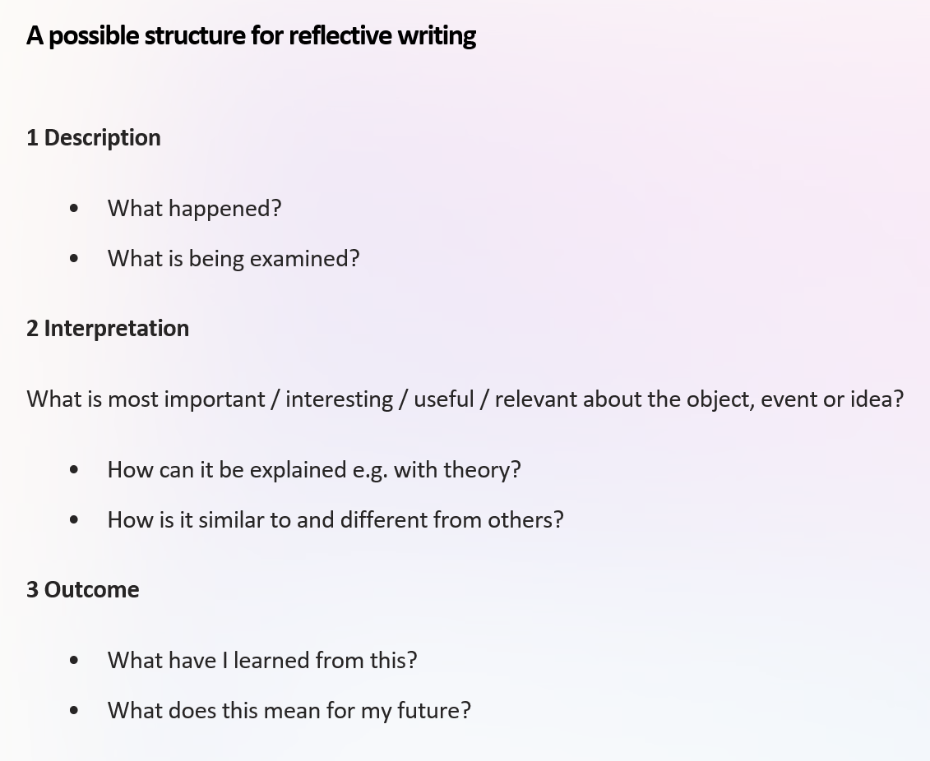
Reflective Writing
Reflective writing is about reflective thinking, which involves:
Looking Back:
Revisit an event, idea, or object.
Analyzing:
Examine deeply from different angles.
Explain using relevant models or theories.
Personal Meaning:
Here is some language to help (see Online).
Consider its impact on your learning or professional growth.
Reflective writing is more personal than typical academic writing
and requires deeper reflection than everyday thinking.

Slide 21
Productive Writing Skills & Test
Thank you!
Seanan
Oh, can you fill out an Exit Ticket? ☺

